Slide 1
XAMPP Server

Slide 2
XAMPP Server
XAMPP stands for Cross-Platform (X), Apache (A), MySQL (M), PHP (P) and Perl(P).
It is a simple, light-weighted Apache server that makes it extremely easy for developers to create a local http server
Free software
‹#›

Slide 3
Features and Requirements of XAMPP
Requires only one .exe or .zip file for configurations (no
configuration of various components of server is required)
It regularly updates latest release of Apache/MySQL/PHP/Perl
Installing XAMPP takes less time than installing individual
components
Self contained and multiple instances of XAMPP can exist on
same computer
‹#›

Slide 4
Starting XAMPP Server
Open XAMPP control panel
Start Apache, MySQL services( required services)
Minimize the Control Panel
Save your folder(containing multiple webpages) in htdocs
folder inside xampp folder (.html/.php/.js/.css)
Check if the XAMPP server has started properly by
Create a web page
Go to Web browser (type : localhost/sample)
‹#›
• View the page

Slide 5
Basics of PHP

Slide 6
What is PHP?
PHP is an acronym for "PHP: Hypertext Preprocessor"
PHP is a widely-used, open source scripting language
PHP scripts are executed on the server
‹#›

Slide 7
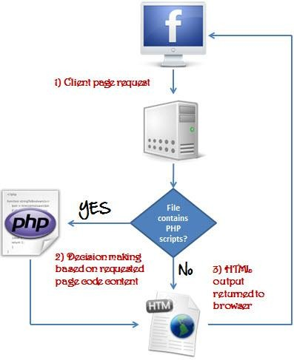
What is a PHP File?
PHP files can contain text, HTML, CSS, JavaScript, and PHP code
PHP files have extension ".php"
‹#›

Slide 8
What Can PHP Do?
Generate dynamic page content
Create, open, read, write, delete, and close files on the server
Collect form data
Send and receive cookies
Add, delete, modify data in your database
To control user-access
Data encryption
With PHP can generate output HTML, images, PDF files, and even
Flash movies.
‹#›

Slide 9
Why PHP?
PHP runs on various platforms (Windows, Linux, Unix, Mac OS X,
etc.)
PHP is compatible with almost all servers used today (Apache, IIS
etc.)
PHP supports a wide range of databases
PHP is free. Download it from the official PHP resource: www.php.net
PHP is easy to learn and runs efficiently on the server side
‹#›

Slide 10
Install PHP
To install PHP, suggest you to install AMP (Apache, MySQL, PHP)
software stack.
It is available for all operating systems. There are many AMP options
available in the market that are given below:
WAMP for Windows
(http://www.wampserver.com/en/)
LAMP for Linux
(http://csg.sph.umich.edu/abecasis/LAMP/download/)
MAMP for Mac (https://www.mamp.info/en/downloads/)
XAMPP (Cross, Apache, MySQL, PHP, Perl) for Cross Platform
(https://www.apachefriends.org/download.html)

Slide 11
Example of PHP
<!DOCTYPE html>
<html>
<body>
<h1>My first PHP page</h1>
<?php
echo "Hello World!";
?>
</body>
</html>
In PHP, all keywords (e.g. if, else, while, echo, etc.), classes, functions, and user-defined functions are NOT case-sensitive. However; all variable names are case-sensitive.
11

Slide 12
PHP echo
PHP echo is a language construct not a function, so you don't need to use parenthesis with it.
But if you want to use more than one parameters, it is
required to use parenthesis.
Syntax:
void echo ( string $arg1 [, string $... ] )
PHP echo statement can be used to print string, multi
line strings, escaping characters, variable, array etc.

Slide 13
Example: PHP echo
<?php
echo "Hello by PHP echo";
//print string
echo "Hello by PHP echo this is multi line
text printed by
PHP echo statement
";
// multi line string
echo "Hello escape \"sequence\" characters";
//escape characters
$msg="Hello JavaTpoint PHP"; echo "Message is: $msg";
//print variable value
?>

Slide 14
Examples
echo “ Hello”, “World”;
echo “Hello”.”World”;
Echo “<ul>”;
echo “<li> Hello India </li>”;
Echo “</ul>”;
echo 500;

Slide 15
PHP print
Like PHP echo, PHP print is a language construct, so you don't need to use parenthesis with the argument list. Unlike echo, it always returns 1.
Syntax:
int print(string $arg)
PHP print statement can be used to print string, multi line
strings, escaping characters, variable, array etc.

Slide 16
Example: PHP print
<?php
print "Hello by PHP echo"; //print string
print "Hello by PHP echo this is multi line
text printed by
PHP echo statement
";
// multi line string
print "Hello escape \"sequence\" characters";
//escape characters
$msg="Hello PHP";
print "Message is: $msg";
//print variable value
?>

Slide 17
PHP echo and print Statements
echo and print are more or less the same.
Used to output data to the screen.
Differences:
echo has no return value while print has a return value of 1 so it can be used in expressions
echo can take multiple parameters (although such usage is rare) while print can take one argument.
echo is marginally faster than print.
16

Slide 18
PHP Variables
A variable starts with the $ sign, followed by the name of the variable
A variable name must start with a letter or the underscore character
A variable name can only contain alpha-numeric characters
and underscores (A-z, 0-9, and _ )
A variable name cannot start with a number
Variable names are case-sensitive ($age and $AGE are two
different variables)
PHP has three different variable scopes:
local
global
static
17

Slide 19
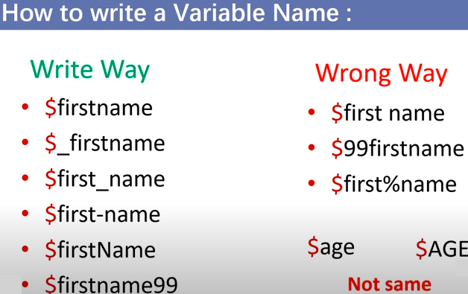

Slide 20
Example: Variables
<!DOCTYPE html>
<html>
<body>
<?php
$txt = "Hello world!";
$x = 5;
$y = 10.5;
echo $txt; echo "<br>"; echo $x; echo "<br>"; echo $y;
?>
</body> </html>
18

Slide 21
Example: Variables
<?php
$txt = ”K J Somaiya College of Engineering"; echo ”Name of my College is $txt";
?>
Same as
<?php
$txt = ”K J Somaiya College of Engineering ";
echo ”Name of my College is " . $txt . ”!!";
?>

Slide 22
What will be the output of
<?php
$x =15;
$y =41;
echo $x + $y;
?>
Output: 1541 Or 56

Slide 23
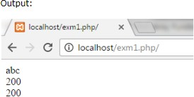
PHP $ and $$ Variables
The $var (single dollar) is a normal variable with the name var
that stores any value like string, integer, float, etc.
The $$var (double dollar) is a reference variable that stores
the value of the $variable inside it.
<?php
$x = "abc";
$$x = 200;
echo $x."<br/>"; echo $$x."<br/>"; echo $abc;
?>

Slide 24
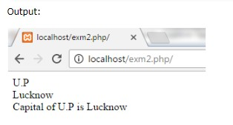
Example:
<?php
$x="U.P";
$$x="Lucknow"; echo $x. "<br>"; echo $$x. "<br>";
echo "Capital of $x is " . $$x;
?>

Slide 25
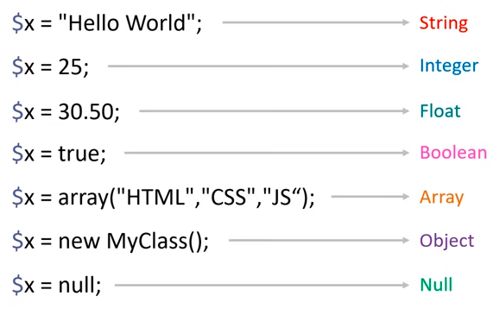
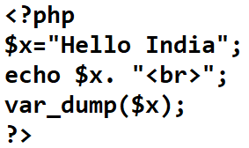
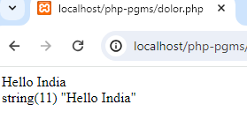
Data types
Var_dump()-
Return datatype of a variable

Slide 26
PHP Constants
A constant is an identifier (name) for a simple value.
The value cannot be changed during the script.
A valid constant name starts with a letter or underscore (no $
sign before the constant name).
PHP constants can be defined by 2 ways:
Using define() function
Syntax:
define(name, value, case-Insensitive)
-1.name of the variable
-2. value-value of the variable
-3. fix the case sensitivity of variable (true or false)
default value is false
Using const keyword
It is a language construct not a function.
It is bit faster than define().
It is always case sensitive.
23

Slide 27
Example: Constants
<?php
define(“College", ”K J Somaiya College of Engineering ");
echo College;
define(“College", ”K J Somaiya College of Engineering “, true);
echo College;
const MESSAGE=" K J Somaiya College of Engineering ";
echo MESSAGE;
?>

Slide 28
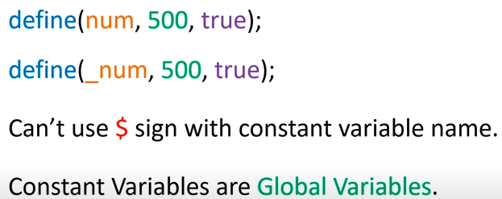
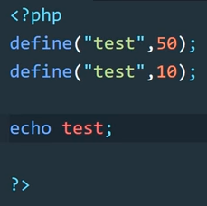
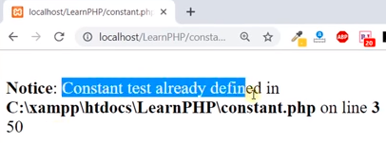
Php Constants

Slide 29
PHP Operators
Operators are used to perform operations on variables and
values.
Arithmetic operators
Assignment operators
Comparison operators
Increment/Decrement operators
Logical operators
String operators
Array operators

Slide 30
Arithmetic Operators
Operat or | Name | Exampl e | Result
+ | Addition | $x + $y | Sum of $x and $y
- | Subtraction | $x - $y | Difference of $x and $y
* | Multiplicati on | $x * $y | Product of $x and $y
/ | Division | $x / $y | Quotient of $x and $y
% | Modulus | $x % $y | Remainder of $x divided by $y
** | Exponentia tion | $x ** $y | Result of raising $x to the $y'th power

Slide 31
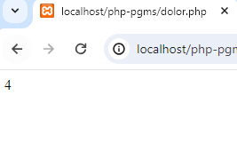
Arithmetic Operator: Example
<!DOCTYPE html>
<html>
<body>
<?php
$x = 10;
$y = 6;
echo $x - $y;
?>
</body>
</html>
27

Slide 32
Assignment Operators
Assignmen t | Same as... | Description
x = y | x = y | The left operand gets set to the value of the expression on the right
x += y | x = x + y | Addition
x -= y | x = x - y | Subtraction
x *= y | x = x * y | Multiplication
x /= y | x = x / y | Division
x %= y | x = x % y | Modulus
28

Slide 33
Assignment Operator: Example
<!DOCTYPE html>
<html>
<body>
<?php
$x = 20;
$x += 100;
echo $x;
?>
</body>
</html>
29

Slide 34
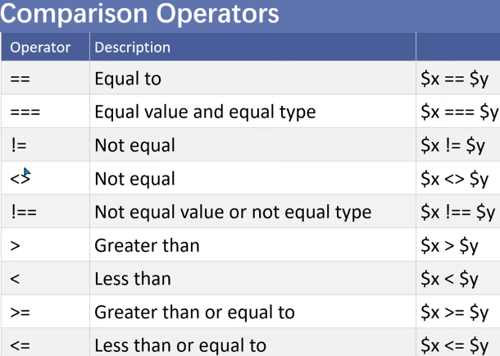
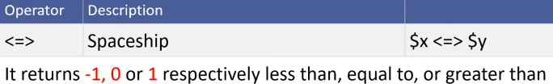

Slide 35
Comparison Operator: Example
<!DOCTYPE html>
<html>
<body>
<?php
$x = 100;
$y = "100";
Echo $x === $y;
?>
</body> </html>
Output:
(blank)

Slide 36
Increment / Decrement Operator
Operator | Name | Description
++$x | Pre-increment | Increments $x by one, then returns $x
$x++ | Post-increment | Returns $x, then increments $x by one
--$x | Pre-decrement | Decrements $x by one, then returns $x
$x-- | Post-decrement | Returns $x, then decrements $x by one

Slide 37
Increment / Decrement Operator: Example
<!DOCTYPE html>
<html>
<body>
<?php
$x = 10;
echo ++$x;
?>
</body>
</html>

Slide 38
Logical Operator
Operat or | Name | Example | Result
and | And | $x and $y | True if both $x and $y are true
or | Or | $x or $y | True if either $x or $y is true
xor | Xor | $x xor $y | True if either $x or $y is true, but not both
&& | And | $x && $y | True if both $x and $y are true
|| | Or | $x || $y | True if either $x or $y is true
! | Not | !$x | True if $x is not true

Slide 39
Logical Operator: Example
<!DOCTYPE html>
<html>
<body>
<?php
$x = 100;
$y = 50;
if ($x == 100 && $y == 50) {
echo "Hello world!";
}
?>
</body>
</html>
35

Slide 40
Comments in PHP
<html>
<body>
<?php
// This is a single-line comment
# This is also a single-line comment
/*
This is a multiple-lines comment block
that spans over multiple lines
*/
// You can also use comments to leave out parts of a code line
$x = 5 /* + 15 */ + 5; echo $x;
?> </body> </html>
36

Slide 41
PHP Data Types
String
Integer
Float (also called double)
Boolean
Scalar Data types
Array
Object
NULL
Resource
Compound Data Types
Special Data types
The PHP var_dump() function returns the data type and value
37

Slide 42
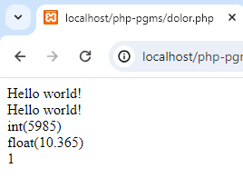
String, Integer, Float and Boolean: Example
<?php
$x = "Hello world!";
$y = 'Hello world!';
echo $x; echo "<br>";
echo $y;
$x = 5985;
var_dump($x);
echo "<br>";
$x = 10.365;
var_dump($x);
echo "<br>";
$m=true;
echo $m;
?>
38

Slide 43
Array: Example
<!DOCTYPE html>
<html>
<body>
<?php
$animals = array(”Elephant ",”Dog","Tiger");
var_dump($animals);
?>
</body>
</html>
Output:
array(3) { [0]=> string(8) ”Elephant" [1]=> string(3) ”Dog" [2]=> string(5) "Tiger" }
39

Slide 44
Object: Example
An object is a data type which stores data and information on how to process that data.
<?php
class Car {
function Car() {
$this->model = "VW";
}
}
// create an object
$c1 = new Car();
// show object properties
echo $c1->model;
?>
Output:
VW
40

Slide 45
NULL :Example
Null is a special data type which can have only one value: NULL.
A variable of data type NULL is a variable that has no value assigned to it.
Tip: If a variable is created without a value, it is automatically assigned a
value of NULL.
<!DOCTYPE html>
<html>
<body>
<?php
$x = "Hello world!";
$x = null; var_dump($x);
?>
Output:
null
</body>
</html>
41

Slide 46

Resource: Example
It refers the external resources like database connection, FTP
connection, file pointers, etc.
In simple terms, a resource is a special variable which carrying a reference to an external resource.
Example:
<?php
$conn = ftp_connect("127.0.0.1") or die("Could not connect");
echo get_resource_type($conn);
?>

Slide 47
Conditional Statement
if statement - executes some code if one condition is true
if...else statement - executes some code if a condition is true and another code if that condition is false
if...elseif....else statement - executes different codes for more
than two conditions
switch statement - selects one of many blocks of code to be
executed

Slide 48
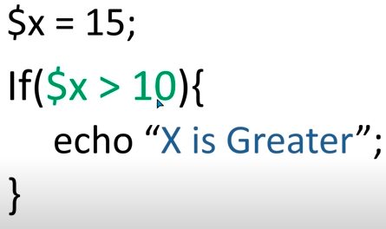
if statement
The if statement executes some code if one condition is true.
Example:
<!DOCTYPE html>
<html>
<body>
<?php
$t = date("H");
if ($t < "20") {
echo "Have a good day!";
}
?>
</body>
</html>

Slide 49
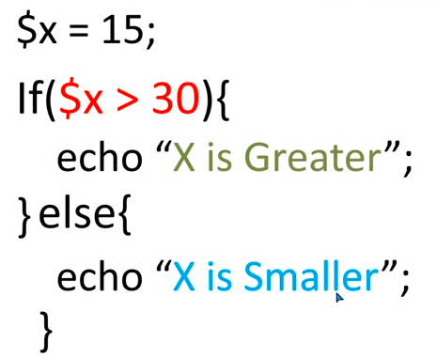
if...else Statement
The if....else statement executes some code if a condition is true and another code if that condition is false.
Example:
<!DOCTYPE html>
<html>
<body>
<?php
$t = date("H");
if ($t < "20") {
echo "Have a good day!";
} else {
echo "Have a good night!";
}
?>
</body>
</html>
45

Slide 50
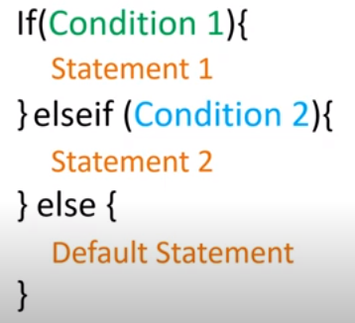
if...elseif....else Statement
<!DOCTYPE html>
<html>
<body>
<?php
$t = date("H");
echo "<p>The hour (of the server) is " . $t;
echo ", and will give the following message:</p>";
if ($t < "10") {
echo "Have a good morning!";
} elseif ($t < "20") {
echo "Have a good day!";
} else {
echo "Have a good night!";
}
?>
46
</body>
</html>

Slide 51
switch Statement
<!DOCTYPE html>
<html>
<body>
<?php
$favcolor = "red";
switch ($favcolor) {
case "red":
echo "Your favorite color is red!";
break;
case "blue":
echo "Your favorite color is blue!";
break;
case "green":
echo "Your favorite color is green!";
break;
default:
echo "Your favorite color is neither red, blue, nor green!";
}
?>
47
</body> </html>

Slide 52
PHP Loops
while - loops through a block of code as long as the specified
condition is true
do...while - loops through a block of code once, and then repeats the loop as long as the specified condition is true
for - loops through a block of code a specified number of
times
foreach - loops through a block of code for each element in an
array

Slide 53
while Loop
<!DOCTYPE html>
<html>
<body>
<?php
$x = 1;
while($x <= 5) {
echo "The number is: $x <br>";
$x++;
}
?>
</body>
</html>

Slide 54
do...while Loop
<!DOCTYPE html>
<html>
<body>
<?php
$x = 1;
do {
echo "The number is: $x <br>";
$x++;
} while ($x <= 5);
?>
</body>
</html>

Slide 55
for Loop
<!DOCTYPE html>
<html>
<body>
<?php
for ($x = 0; $x <= 10; $x++) {
echo "The number is: $x <br>";
}
?>
</body>
</html>

Slide 56
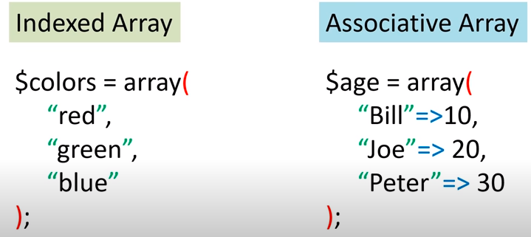
Types of array in PHP

Slide 57
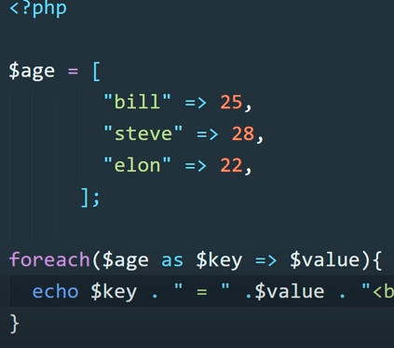
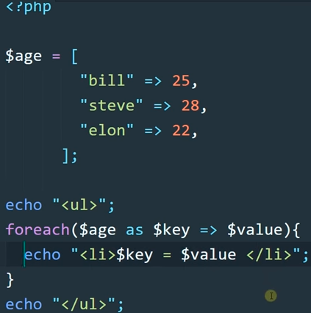
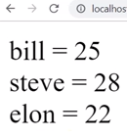
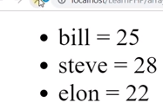
foreach loop for Associative array:

Slide 58
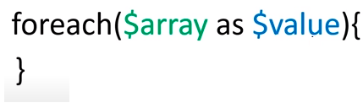
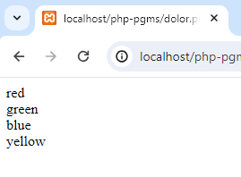
foreach loop
The foreach loop works only on arrays, and is used to loop through
each key/value pair in an array.
<!DOCTYPE html>
<html>
<body>
<?php
$colors = array("red", "green", "blue", "yellow");
foreach ($colors as $value) {
echo "$value <br>";
}
?>
</body>
</html>

Slide 59
PHP Functions
PHP function is a piece of code that can be reused many times. It can take input as argument list and return value. There are thousands of built-in functions in PHP.
In PHP, we can define Conditional function, Function within
Function and Recursive function also.
Advantage of PHP Functions:
Code Reusability:
PHP functions are defined only once and can be invoked many times, like in other programming languages.
Less Code:
It saves a lot of code because you don't need to write the logic many times. By the use of function, you can write the logic only once and reuse it.
Easy to understand:
PHP functions separate the programming logic. So it is easier to understand the flow of the application because every logic is divided
in the form of functions.

Slide 60
User Defined Functions
A function is a block of statements that can be used repeatedly
in a program.
A function will not execute immediately when a page loads.
A function will be executed by a call to the function.
Call by value:
<?php
function trialFunction($Name, $Marks)
{
echo "$Name got $Marks .<br>";
}
trialFunction("Amit","97");
trialFunction("Ajay","78");
trialFunction("Zoya","83");
54
?>

Slide 61
PHP Call By Reference
Value passed to the function doesn't modify the actual value by
default (call by value).
But we can do so by passing value as a reference.
By default, value passed to the function is call by value.
To pass value as a reference, you need to use ampersand (&) symbol before the argument name.
Example:
<?php
function adder(&$str2)
{
$str2 .= 'Call By Reference';
}
$str = 'Hello '; adder($str); echo $str;
Output:
Hello Call By Reference
?>

Slide 62
PHP Function: Default Argument Value
<?php
function sayHello($name="Sonoo"){
echo "Hello $name<br/>";
}
sayHello("Rajesh"); sayHello();//passing no value sayHello("John");
?>
Output: Hello Rajesh Hello Sonoo Hello John

Slide 63
PHP Function: Returning Value
<?php
function cube($n)
{
return $n*$n*$n;
}
echo "Cube of 3 is: ".cube(3);
?>
Output:
Cube of 3 is: 27

Slide 64
PHP Recursive Function
<?php
function display($number) {
if($number<=5){
echo "$number <br/>";
display($number+1);
}
}
display(1);
?>
Output:
1
2
3
4
5

Slide 65
PHP String Functions
strlen()
returns the length of a string
str_word_count()
counts the number of words in a string
strrev()
reverses a string
strpos()
searches for a specific text within a string(returns position of
first match)
str_replace()
replaces some characters with some other characters in a
string.
59

Slide 66
PHP Arrays
PHP array is an ordered map (contains value on the basis of key). It is
used to hold multiple values of similar type in a single variable.
Advantage of PHP Array
Less Code:
We don't need to define multiple variables.
Easy to traverse:
By the help of single loop, we can traverse all the elements of an
array.
PHP Array Types
Indexed Array
Associative Array
Multidimensional Array

Slide 67
Example: Arrays
<?php
$season=array("summer","winter","spring","autumn");
echo "Season are: $season[0], $season[1], $season[2] and $season[3]";
?>
Output:
Season are: summer, winter, spring and autumn
<?php
$salary=array("Sonoo"=>"350000","John"=>"450000","Kartik"=>"200000");
echo "Sonoo salary: ".$salary["Sonoo"]."<br/>"; echo "John salary: ".$salary["John"]."<br/>"; echo "Kartik salary: ".$salary["Kartik"]."<br/>";
?>
Output:
Sonoo salary: 350000
John salary: 450000
Kartik salary: 200000

Slide 68
Example: Arrays
<?php
$emp = array
(
array(1,"sonoo",400000), array(2,"john",500000), array(3,"rahul",300000)
);
for ($row = 0; $row < 3; $row++) { for ($col = 0; $col < 3; $col++) { echo $emp[$row][$col]." ";
}
echo "<br/>";
}
?>
Output:
1 sonoo 400000
2 john 500000
3 rahul 300000

Slide 69
Array Operators
Operat or | Name | Example | Result
+ | Union | $x + $y | Union of $x and $y
== | Equality | $x == $y | Returns true if $x and $y have the same key/value pairs
=== | Identity | $x === $y | Returns true if $x and $y have the same key/value pairs in the same order and of the same types
!= | Inequality | $x != $y | Returns true if $x is not equal to $y
<> | Inequality | $x <> $y | Returns true if $x is not equal to $y
63

Slide 70
Array Operators: Example
<!DOCTYPE html>
<html>
<body>
<?php
$x = array("a" => "red", "b" => "green");
$y = array("c" => "blue", "d" => "yellow");
var_dump($x != $y);
?>
</body>
</html>
64

Slide 71
Array Functions(1)
PHP array_change_key_case() function
Syntax
array array_change_key_case ( array $array [, int $case = CASE_LOWER] )
Note: It changes case of key only.
Example
<?php
$salary=array("Sonoo"=>"550000","Vimal"=>"250000","Ratan"=>"200000");
print_r(array_change_key_case($salary,CASE_UPPER));
?>
Output:
Array ( [SONOO] => 550000 [VIMAL] => 250000 [RATAN] => 200000 )

Slide 72
Array Functions(2)
PHP array_chunk() function
PHP array_chunk() function splits array into chunks. By using array_chunk() method, you can divide array into many parts.
Syntax
array array_chunk ( array $array , int $size [, bool $preserve_keys = false ] )
Example
<?php
$salary=array("Sonoo"=>"550000","Vimal"=>"250000","Ratan"=>"200000")
print_r(array_chunk($salary,2));
?>
Output:
Array ( [0] => Array ( [0] => 550000 [1] => 250000 )
[1] => Array ( [0] => 200000 ) )

Slide 73
Array Functions(3)
PHP count() function
PHP count() function counts all elements in an array.
Syntax
int count ( mixed $array_or_countable [, int $mode = COUNT_NORMAL ] )
Example
<?php
$season=array("summer","winter","spring","autumn");
echo count($season);
?>
Output:
4

Slide 74
Array Functions(4)
PHP sort() function
PHP sort() function sorts all the elements in an array.
Syntax
bool sort ( array &$array [, int $sort_flags = SORT_REGULAR ] )
Example
<?php
$season=array("summer","winter","spring","autumn");
sort($season);
foreach( $season as $s )
{
Output: autumn spring summer winter
echo "$s<br />";
}
?>

Slide 75
Array Functions(5)
PHP array_reverse() function
PHP array_reverse() function returns an array containing elements in
reversed order.
Syntax
array array_reverse ( array $array [, bool $preserve_keys = false ] )
Example
<?php
$season=array("summer","winter","spring","autumn");
$reverseseason=array_reverse($season);
foreach( $reverseseason as $s )
{
Output:
echo "$s<br />";
autumn spring winter summer
}
?>

Slide 76
Array Functions(6)
PHP array_search() function
PHP array_search() function searches the specified value in an array. It returns key if search is successful.
Syntax
mixed array_search ( mixed $needle , array $haystack [, bool $strict = false ] )
Example
<?php
$season=array("summer","winter","spring","autumn");
$key=array_search("spring",$season);
echo $key;
?>
Output:
2

Slide 77
Array Functions(7)
PHP array_intersect() function
PHP array_intersect() function returns the intersection of two array.
In other words, it returns the matching elements of two array.
Syntax
array array_intersect ( array $array1 , array $array2 [, array $... ] )
Example
<?php
$name1=array("sonoo","john","vivek","smith");
$name2=array("umesh","sonoo","kartik","smith");
$name3=array_intersect($name1,$name2);
foreach( $name3 as $n )
{
echo "$n<br />";
}
?>
Output: sonoo smith

Slide 78
PHP String
PHP string is a sequence of characters i.e., used to store and
manipulate text.
PHP supports only 256-character set and so that it does not offer native Unicode support.
There are various ways to specify a string literal in PHP.
single quoted
double quoted
heredoc syntax
newdoc syntax (since PHP 5.3)

Slide 79
PHP String
Single Quoted
We can create a string in PHP by enclosing the text in a single- quote.
It is the easiest way to specify string in PHP.
For specifying a literal single quote, escape it with a backslash (\) and to specify a literal backslash (\) use double backslash (\\).
Example:
<?php
$str='Hello text within single quote';
echo $str;
Output:
Hello text within single quote
?>

Slide 80
PHP String
<?php
$literal_single_quote = 'I\'m using a literal single quote.';
$literal_backslash = 'This is a literal backslash: \\';
echo $literal_single_quote . "<br />";
echo $literal_backslash;
?>

Slide 81
PHP String
Double Quoted
In PHP, we can specify string through enclosing text within double quote also. But escape sequences and variables will be interpreted using double quote PHP strings.
Example 1
<?php
$str="Hello text within double quote";
echo $str;
?>
Output:
Hello text within double quote

Slide 82
PHP String
$name = 'John';
echo "Hello, $name!"; // Output: Hello, John!
echo "This is a tab: \t and this is a newline: \n";
$age = 30;
echo "You are $age years old."; // Output: You are 30 years old.
echo "She said 'Hello'."; // Output: She said 'Hello'.
echo 'She said "Hello".'; // Output: She said "Hello".

Slide 83
String Function(1)
PHP strtoupper() function
The strtoupper() function returns string in uppercase letter.
Syntax
string strtoupper ( string $string )
Example
<?php
$str="My name is abc";
$str=strtoupper($str);
echo $str;
?>
Output:
MY NAME IS ABC

Slide 84
String Function(2)
PHP ucfirst() function
The ucfirst() function returns string converting first character into uppercase. It doesn't change the case of other characters.
Syntax
string ucfirst ( string $str )
Example
<?php
$str="my name is abc";
$str=ucfirst($str);
echo $str;
?>
Output:
My name is abc

Slide 85
String Function(3)
PHP ucwords() function
The ucwords() function returns string converting first character of each word into uppercase.
Syntax
string ucwords ( string $str )
Example
<?php
$str="my name is Sonoo jaiswal";
$str=ucwords($str);
echo $str;
Output:
?>
My Name Is Sonoo Jaiswal

Slide 86
String Function(4)
PHP strrev() function
The strrev() function returns reversed string.
Syntax
string strrev ( string $string )
Example
<?php
$str="my name is Sonoo jaiswal";
$str=strrev($str);
echo $str;
Output:
?>
lawsiaj oonoS si eman ym

Slide 87
String Function(5)
PHP strlen() function
The strlen() function returns length of the string.
Syntax
int strlen ( string $string )
Example
<?php
$str="my name is Sonoo jaiswal";
$str=strlen($str);
echo $str;
?>
Output:
24

Slide 88
String: Example
<!DOCTYPE html>
<html>
<body>
<?php
echo strlen("Hello world!");
echo str_word_count("Hello world!");
echo strrev("Hello world!");
echo strpos("Hello world!", "world");
echo str_replace("world", "Dolly", "Hello world!");
?>
</body>
</html>
80

Slide 89
String | g Operat | or
Opera tor | Name | Example | Result
. | Concatenati on | $txt1 . $txt2 | Concatenation of $txt1 and $txt2
.= | Concatenati on assignment | $txt1 .= $txt2 | Appends $txt2 to $txt1
 |  |  | 81

Slide 90
String Operator: Example
<!DOCTYPE html>
<html>
<body>
<?php
$txt1 = "Hello";
$txt2 = " world!";
echo $txt1 . $txt2;
?>
</body>
</html>
$string1 = "Hello ";
$string2 = "world!";
$string1 .= $string2;
echo $string1; // Output: Hello world!
82

Slide 91
HTML Forms
HTML Forms are required, when you want to collect some data from the site visitor.
For example, during user registration you would like to collect information such as name, email address, credit card, etc.
A form will take input from the site visitor and then will post it to a back-end application such as CGI, ASP Script or PHP script etc.
There are various form elements available like text fields, textarea fields, drop-down menus, radio buttons, checkboxes, etc.
84

Slide 92
Forms Syntax
<form action = "Script URL“ method = "GET|POST">
form elements like input, textarea etc.
</form>
action
Backend script ready to process your passed data.
method
Method to be used to upload data. The most frequently
used are GET and POST methods.
85

Slide 93
Forms Syntax
Form elements
Text Input Controls , Checkboxes Controls, Radio Box Controls, Select Box Controls, File Select boxes , Hidden Controls,
Clickable Buttons , Submit and Reset Button
target
Specify the target window or frame where the result of the
script will be displayed. It takes values like _blank, _self,
_parent etc.
86

Slide 94
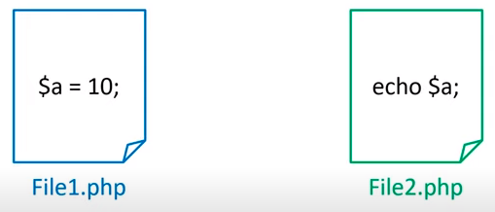
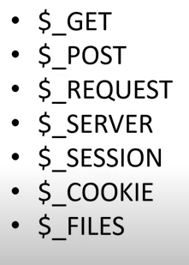
$GLOBALS['myVar'] = "Hello";
// Now $myVar is accessible globally

Slide 95
GET Method
The default method when submitting form data is GET.
However, when GET is used, the submitted form data will be visible in the page address field:
When to use GET??
Appends form-data into the URL in name/value pairs
The length of a URL is limited (about 3000 characters)
Never use GET to send sensitive data! (will be visible in the
URL)
Useful for form submissions where a user wants to bookmark
the result
GET is better for non-secure data, like query strings in Google
87

Slide 96
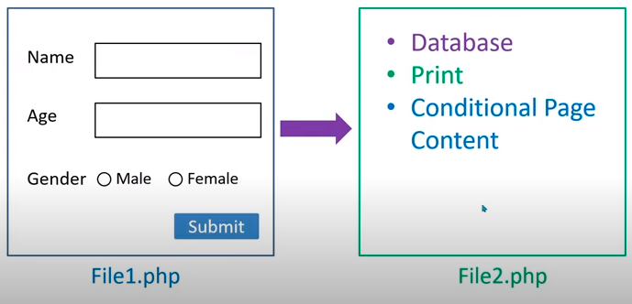

Slide 97
<!DOCTYPE html>
<html>
<body>
<p>This form will be submitted using the GET method:</p>
<form method="GET“ target="_blank" >
First name:<br>
<input type="text" name="firstname" >
<br>
Last name:<br>
<input type="text" name="lastname" >
<br><br>
<input type="submit" value="Submit">
</form>
</body>
</html>
88

Slide 98
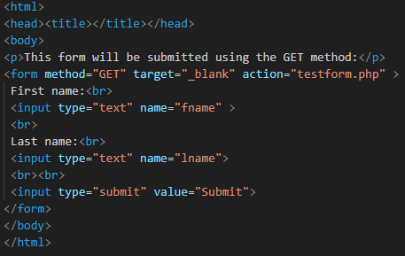
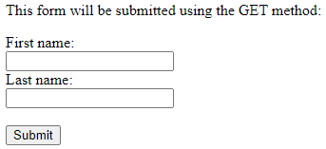
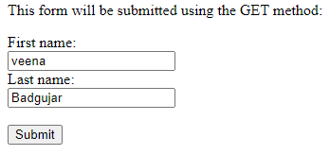
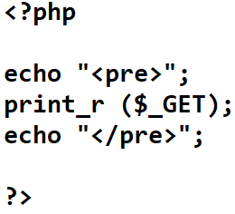
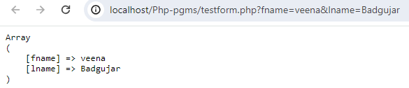
Testform.php

Slide 99
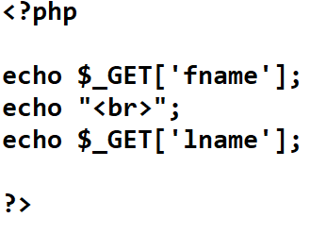


Slide 100
POST Method
Always use POST if the form data contains sensitive or personal information.
The POST method does not display the submitted form
data in the page address field.
When to use POST??
POST has no size limitations, and can be used to send large
amounts of data.
Form submissions with POST cannot be bookmarked
89

Slide 101
<!DOCTYPE html>
<html>
<body>
<p>This form will be submitted using the POST method:</p>
<form method="POST“ target="_blank" >
First name:<br>
<input type="text" name="firstname" value="Mickey">
<br>
Last name:<br>
<input type="text" name="lastname" value="Mouse">
<br><br>
<input type="submit" value="Submit">
</form>
</body>
</html>
90

Slide 102
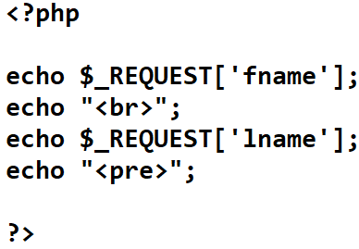
PHP REQUEST method
$_REQUEST is a PHP super global variable which contains submitted form data, and all cookie data.
In other words, $_REQUEST is an array containing data from $_GET, $_POST, and $_COOKIE.
Using $_REQUEST on $_POST Requests
POST request are usually data submitted from an HTML form.
Example:
PHP file-

Slide 103
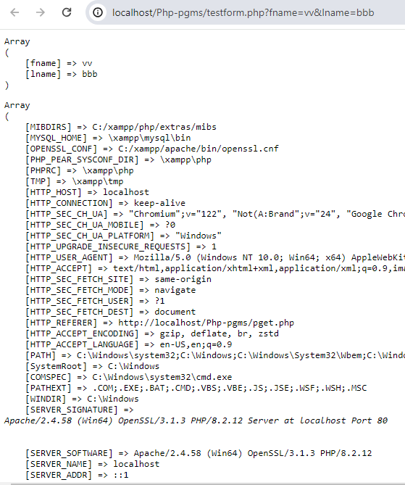
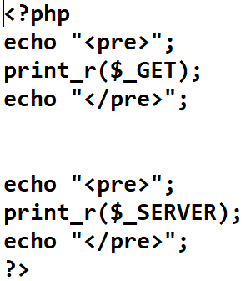
$_SERVER
$_SERVER is a PHP super global variable which holds information about headers, paths, and script locations.

Slide 104
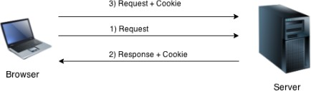
PHP Cookie
PHP cookie is a small piece of information which is stored at
client browser. It is used to recognize the user.
Cookie is created at server side and saved to client browser.
Each time when client sends request to the server, cookie is embedded with request. Such way, cookie can be received at the server side.
In short, cookie can be created, sent and received at server
end.

Slide 105
PHP Cookie (contd..)
PHP setcookie() function –create cookie
PHP setcookie() function is used to set cookie with HTTP response.
Once cookie is set, you can access it by $_COOKIE superglobal variable.
Syntax
bool setcookie ( string $name [, string $value [, int $expire = 0 [, string $pa
th [, string $domain [, bool $secure = false [, bool $httponly = false ]]]]]] )
Example
expire-
1hr=60*60=3600 sec
24hr=3600*24=86,400sec
Time()+(86400) //for 24 hrs
Time()+(86400 *30) //for 1 month
Path- “/” // you can access it from any page.
Domain= //access cookies from specific domain
Secure=true/false
Httponly=true/false

Slide 106
setcookie("CookieName", "CookieValue");
/* defining name and value only*/
setcookie("CookieName", "CookieValue", time()+1*60*60);
//using expiry in 1 hour(1*60*60 seconds or 3600 seconds)
setcookie("CookieName", "CookieValue", time()+1*60*60, "/mypath/", " mydomain.com", 1);

Slide 107
PHP Cookie (contd..)
PHP $_COOKIE
PHP $_COOKIE superglobal variable is used to get cookie.
Example
$value=$_COOKIE["CookieName"];//returns cookie value

Slide 108
Example
1) create cookie:
$cookie_name=“user”;
$cookie_value=“John”;
setcookie(cookie_name, cookie_value,time()+(86400),”/”);
// defining 4 parameters.
2) View cookie:
$_COOKIE[name];
PHP $_COOKIE
PHP $_COOKIE superglobal variable is used to get cookie.
Example
$value=$_COOKIE["CookieName"];//returns cookie value

Slide 109
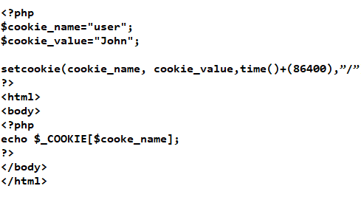
PHP Cookie (contd..)

Slide 110
Example: Cookie
<?php
setcookie("user", "Sonoo");
?>
<html>
<body>
<?php
if(!isset($_COOKIE["user"])) {
echo "Sorry, cookie is not found!";
}
else
{
echo "<br/>Cookie Value: " . $_COOKIE["user"];
}
?>
</body>
</html>
Output:
Sorry, cookie is not found!
Firstly cookie is not set. But, if you refresh the page, you will see cookie is set now.
Cookie Value: Sonoo

Slide 111
PHP Cookie (contd..)
PHP Delete Cookie
If you set the expiration date in past, cookie will be deleted.
Example:
<?php
setcookie ("CookieName", "", time() -3600);
// set the expiration date to one hour ago
?>

Slide 112
PHP Session
PHP session is used to store and pass information from one
page to another temporarily (until user close the website).
PHP session technique is widely used in shopping websites where we need to store and pass cart information e.g. username, product code, product name, product price etc from one page to another.
PHP session creates unique user id for each browser to recognize the user and avoid conflict between multiple browsers.

Slide 113
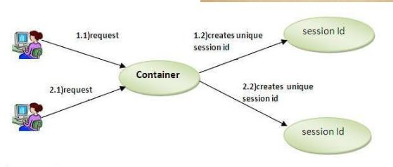
PHP Session

Slide 114
PHP Session
PHP session_start() function
PHP session_start() function is used to start the session. It starts a new or resumes existing session. It returns existing session if session is created already. If session is not available, it creates and returns new session.
Syntax
bool session_start ( void )
Example
session_start();

Slide 115
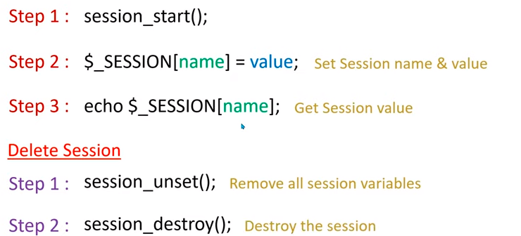

Slide 116
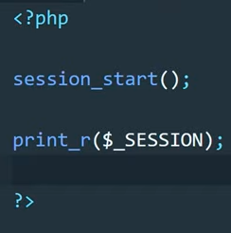
PHP Session
PHP $_SESSION
PHP $_SESSION is an associative array that contains all session variables. It is used to set and get session variable values.
Example: Store information
$_SESSION["user"] = "Sachin";
Example: Get information
echo $_SESSION["user"];

Slide 117
Example: PHP Session
Session1.php
<?php
session_start();
?>
<html>
<body>
<?php
$_SESSION["user"] = "Sachin";
echo "Session information are set successful
ly.<br/>";
?>
<a href="session2.php">Visit next page</a>
</body>
</html>
Session2.php
<?php
session_start();
?>
<html>
<body>
<?php
echo "User is: ".$_SESSION["user"];
?>
</body>
</html>

Slide 118
PHP Session Counter Example
<?php session_start();
if (!isset($_SESSION['counter'])) {
$_SESSION['counter'] = 1;
} else {
$_SESSION['counter']++;
}
echo ("Page Views: ".$_SESSION['counter']);
?>

Slide 119
PHP Session
PHP Destroying Session
PHP session_destroy() function is used to destroy all session variables completely.
<?php session_start(); session_destroy();
?>

Slide 120
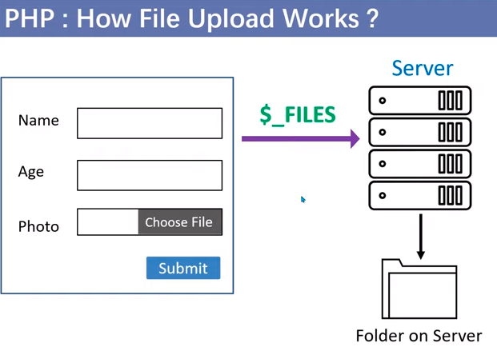
$_File Variable

Slide 121
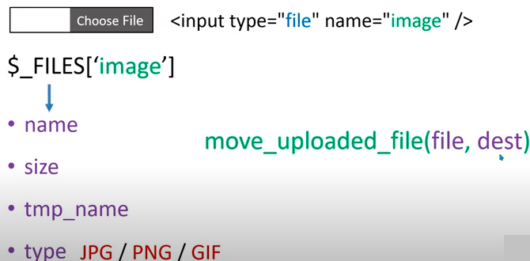

Slide 122
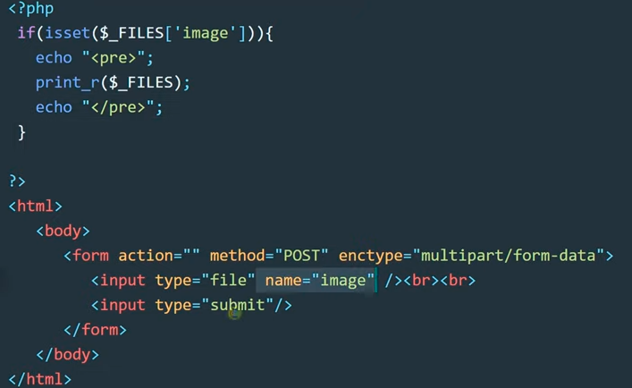
example

Slide 123
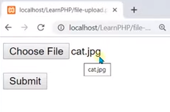
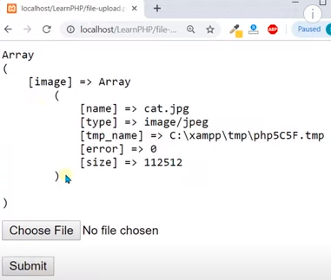

Slide 124
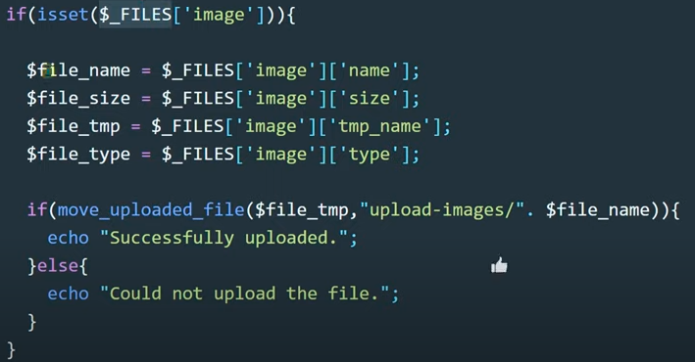

Slide 125
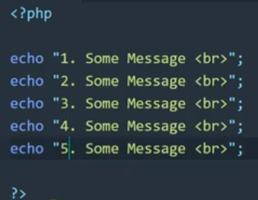
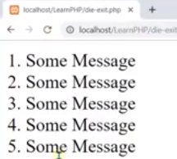
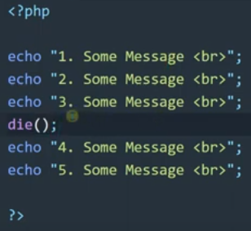

Die and Exit functionsin PHP

Slide 126

File Handling
PHP readfile()-
The readfile() function is useful if all you want to do is open up a file and read its contents.

Slide 127
PHP File Handling
PHP File System allows us to create file, read file line by line, read file character by character, write file, append file, delete file and close file.
PHP Open File - fopen()
The PHP fopen() function is used to open a file
Syntax
fopen ( string $filename , string $mode)
Example
<?php
$handle = fopen("c:\\folder\\file.txt", "r") or die("Unable to open file!");;
?>

Slide 128


Slide 129
PHP File Handling
PHP Close File - fclose()
The PHP fclose() function is used to close an open file pointer.
Syntax
fclose ( file )
Example
<?php fclose($handle);
?>

Slide 130
PHP File Handling
PHP Read File - fread()
The PHP fread() function is used to read the content of the file. It
accepts two arguments: resource and file size.
Syntax
string fread ( resource $handle , int $length )
Example
<?php
$filename = "c:\\myfile.txt";
$handle = fopen($filename, "r");//open file in read mode
$contents = fread($handle, filesize($filename));//read file echo $contents;//printing data of file
fclose($handle);//close file
?>
Output:
hello php file

Slide 131
PHP File Handling
PHP Write File - fwrite()
The PHP fwrite() function is used to write content of the string into
file.
Syntax
int fwrite ( resource $handle , string $string [, int $length ] )
Example
<?php
$fp = fopen('data.txt', 'w');//open file in write mode
fwrite($fp, 'hello '); fwrite($fp, 'php file'); fclose($fp);
echo "File written successfully";
?>
Output:
File written successfully

Slide 132
PHP File Handling
PHP Delete File - unlink()
The PHP unlink() function is used to delete file.
Syntax
bool unlink ( string $filename [, resource $context ] )
Example
<?php unlink('data.txt');
echo "File deleted successfully";
?>

Slide 133
PHP File Handling
PHP Close File - fclose()
The PHP fclose() function is used to close an open file pointer.
Syntax
ool fclose ( resource $handle )
Example
<?php fclose($handle);
?>

Slide 134
PHP File Handling
PHP Read File - fread()
The PHP fread() function is used to read the content of the file. It
accepts two arguments: resource and file size.
Syntax
string fread ( resource $handle , int $length )
Example
<?php
$filename = "c:\\myfile.txt";
$handle = fopen($filename, "r");//open file in read mode
$contents = fread($handle, filesize($filename));//read file echo $contents;//printing data of file
fclose($handle);//close file
?>
Output:
hello php file

Slide 135
PHP File Handling
PHP Write File - fwrite()
The PHP fwrite() function is used to write content of the string into
file.
Syntax
int fwrite ( resource $handle , string $string [, int $length ] )
Example
<?php
$fp = fopen('data.txt', 'w');//open file in write mode
fwrite($fp, 'hello '); fwrite($fp, 'php file'); fclose($fp);
echo "File written successfully";
?>
Output:
File written successfully

Slide 136
PHP File Handling
PHP Delete File - unlink()
The PHP unlink() function is used to delete file.
Syntax
bool unlink ( string $filename [, resource $context ] )
Example
<?php unlink('data.txt');
echo "File deleted successfully";
?>

